Slide 1
Air QualityPrediction using Deep learning models
Harshitha Kambham (RA2011026010235)
Sashank Donavalli (RA2011026010234)
Guide Name: Dr. M. Dhilsath Fathima

Slide 2
Abstract
Air Pollution is a significant environmental concern with far- reaching implications for public health and environment. Monitoring and predicting air pollutant concentrations are essential for effective pollution control and management. This study focuses on the development of a time series prediction model for multiple pollutants in the air using advanced deep learning techniques. The time series data is taken into account, capturing temporal dependencies and seasonal patterns that are inherent in air quality datasets.
This study explores the application of various deep learning architectures, including Recurrent Neural Networks(RNNs) and other hybrid models. This research highlights the effectiveness of deep learning models in Air Qulity prediction and their potential to provide accurate and timely information for air quality monitoring and management. The findings of this study contribute to the advancement of air quality prediction systems, enabling better decision-making for public health and environmental protection.

Slide 3
Problem Statement
Air pollution is a significant environmental concern that poses serious health risks and environmental degradation worldwide. Monitoring and predicting air quality through the Air Quality Index (AQI) is crucial for safeguarding public health and guiding policy decisions. Deep learning models, with their ability to capture intricate patterns in data, offer a promising avenue for improving Air quality prediction accuracy.
The proposed model leverages historical air quality data, including parameters such as particulate matter (PM2.5 and PM10), nitrogen dioxide (NO2), sulfur dioxide (SO2), carbon monoxide (CO), ozone (O3), and meteorological variables, were used as input features for the models. The data were collected from multiple monitoring stations across different geographic locations.

Slide 4
Problem Statement
The performance of these models was evaluated using various metrics, such as mean absolute error (MAE), root mean square error (RMSE), and correlation coefficients. The results demonstrated that deep learning models consistently outperformed traditional machine learning methods and exhibited a higher accuracy in AQI prediction. Key components of the prediction model includes data preprocessing, feature engineering and the selection of appropriate deep learning algorithms.
This research explores the potential impact of external factors such as meteorological data and emission sources on air pollutant concentrations. The findings of this study contribute to the advancement of air quality prediction systems, enabling better decision-making for public health and environmental protection.

Slide 5
Objectives
1. Model Comparision: Compare the performance of various deep learning models, such as Recurrent Neural Networks (RNNs), Long Short Term Memory networks (LSTMs), and hybrid models, in predicting AQI. Determine which model architecture yields the most accurate predictions.
2. Data Preprocessing: Develop and implement effective data preprocessing techniques to handle missing values, outliers, and noise in air quality and meteorological data. Assess how different preprocessing methods impact model performance.
3. Feature Engineering: Investigate the importance of different air quality parameters (e.g., PM2.5, PM10, NO2, SO2, CO, O3) and meteorological variables (e.g., temperature, humidity, wind speed) in AQI prediction. Explore feature selection and extraction methods to identify the most relevant features.

Slide 6
Objectives
4. Hyperparameter Tuning: Optimize hyperparameters for each deep learning model to enhance prediction accuracy. Evaluate the sensitivity of model performance to hyperparameter changes.
5. Temporal Analysis: Investigate the temporal patterns and trends in AQI data, including daily, weekly, and seasonal variations. Develop models capable of capturing and leveraging temporal dependencies in air quality data.
6. Spatial Analysis: Explore the spatial distribution of air quality data by considering data from multiple monitoring stations in different geographic locations. Develop models that can account for spatial correlations and variabilities in AQI.
7. Performance Metrics: Evaluate model performance using appropriate metrics, including Mean Absolute Error (MAE), Root Mean Square Error (RMSE), R-squared (R2), and others. Compare the models based on these metrics.

Slide 7
Objectives
8. Real-time Prediction: Implement a real-time AQI prediction system that can provide timely information to the public and relevant authorities for air quality monitoring and management.
9. Scalability and Generalization: Assess the scalability of the selected models and their ability to generalize across different regions and timeframes. Investigate any limitations or biases that may arise in model generalization.

Slide 8
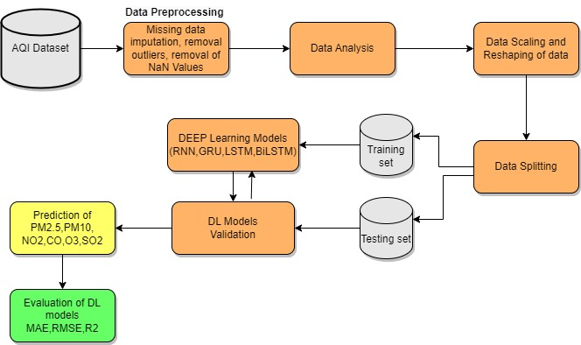
Proposed System Architecture Diagram

Slide 9
Modules Description and Implementation
Data Preprocessing:
Missing values: Using the function fillna_mean(df) the missing values will be filled.
converting year, month, day, hour columns into datetime format
Removal of outlier: Outliers can introduce noise and inaccuracies into your predictive models. By removing outliers, you can improve the overall data quality, which is essential for reliable predictions which can lead to better prediction by model.
Scaling data using MinMaxScaler scales the data so that each feature (column) falls within the [0, 1] range. Scaling can be helpful to ensure that features with different scales do not dominate the learning process.

Slide 10
Modules Description and Implementation
Testing and Training the dataset:
Training data: Define the number of data points to be used for training, which is 70% of the total data points.
Validation data: Define the number of data points to be used for validation, which is 20% of the total data points.
Test data: Define the number of data points to be used for training, which is 10% of the total data points.
Further split each of these subsets into input features (the historical data) and target variables (the data to be predicted).

Slide 11
Modules Description and Implementation
RNN Model
Model Architecture: An InputLayer that accepts input data with the shape of (None, 1, 33), is where the model starts. This shape implies that the model has 33 characteristics and one time step for input sequences. Variable batch sizes are often represented by the "None" dimension.
Following the input layer comes a SimpleRNN (Simple Recurrent Neural Network) layer with 128 units . Recurrent neural network layers called SimpleRNN are utilized for sequence data. Weights and biases are among the 20,736 parameters in the SimpleRNN layer.
A dense layer with 128 units and the label "dense_2" follows the SimpleRNN layer. This layer contains 16,512 parameters and is fully linked.Another dense layer with the name "dense_3" and six units is present, and it is most likely the output layer. The 774 parameters in this layer are.

Slide 12
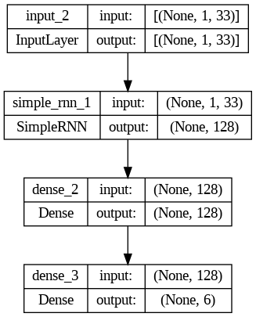
RNN Architecture
_________________________________________________________________
Layer (type) Output Shape Param #
=================================================================
input_2 (InputLayer) [(None, 1, 33)] 0
simple_rnn_1 (SimpleRNN) (None, 128) 20736
dense_2 (Dense) (None, 128) 16512
dense_3 (Dense) (None, 6) 774
=================================================================
Total params: 38022 (148.52 KB)
Trainable params: 38022 (148.52 KB)
Non-trainable params: 0 (0.00 Byte)
_________________________________________________________________

Slide 13
Modules Description and Implementation
GRU Model
Model Architecture: The model's first layer is an InputLayer that accepts input data with the shape of (None, 1, 33). This shape implies that the model anticipates 33 characteristics and one time step for input sequences. Variable batch sizes are often represented by the "None" dimension.
A dense layer with 128 units and follows the input layer. Weights and biases are among the 62,592 parameters in the GRU layer. Recurrent neural network layers called GRUs are employed for sequence data.
A dense layer with 128 units and the name "dense_6" follows the GRU layer. With 16,512 parameters, this layer is dense and fully connected.
Another dense layer with the name "dense_7" and six units is present, and it is most likely the output layer. The 774 parameters in this layer are.

Slide 14
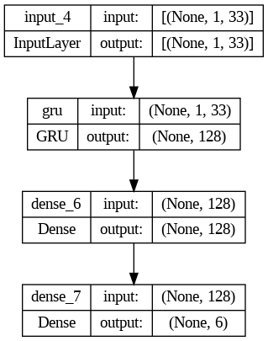
GRU Architecture
_________________________________________________________________
Layer (type) Output Shape Param #
=================================================================
input_4 (InputLayer) [(None, 1, 33)] 0
gru (GRU) (None, 128) 62592
dense_6 (Dense) (None, 128) 16512
dense_7 (Dense) (None, 6) 774
=================================================================
Total params: 79878 (312.02 KB)
Trainable params: 79878 (312.02 KB)
Non-trainable params: 0 (0.00 Byte)

Slide 15
Modules Description and Implementation
LSTM Model
Model Architecture: The model has it's first layer which is an Input layer that accepts input data with the shape of (None, 1, 33). This shape implies that the model anticipates 33 characteristics and one time step for input sequences. Variable batch sizes are often represented by the "None" dimension.
A dense layer of long short-term memory (LSTM) with 128 units follows the input layer. Weights and biases are among the 82,944 parameters in the LSTM layer. Long-term dependencies in sequences can be captured by the LSTM layer, a form of recurrent neural network layer that is employed for sequence data.
A dense layer with 128 units called "dense_8" follows the dense layer. With 16,512 parameters, this layer is dense and fully connected.
Another dense layer with the designation "dense_9" and six units is present at the end, and it is most likely the output layer. The 774 parameters are in this layer.

Slide 16
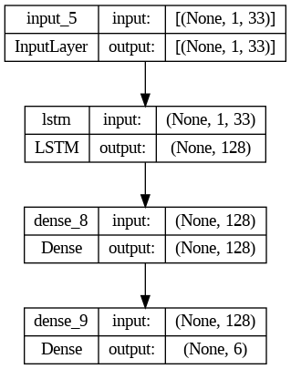
LSTM Architecture
_________________________________________________________________
Layer (type) Output Shape Param #
=================================================================
input_5 (InputLayer) [(None, 1, 33)] 0
lstm (LSTM) (None, 128) 82944
dense_8 (Dense) (None, 128) 16512
dense_9 (Dense) (None, 6) 774
=================================================================
Total params: 100230 (391.52 KB)
Trainable params: 100230 (391.52 KB)
Non-trainable params: 0 (0.00 Byte)

Slide 17
Modules Description and Implementation
BiLSTM Model
Model Architecture:The input layer accepts input data with the shape of (None, 1, 33), is where the model starts. This shape implies that the model anticipates 33 characteristics and one time step for input sequences. Variable batch sizes are often represented by the "None" dimension.A Bidirectional layer with the label "bidirectional" follows the input layer. Sequence data is frequently processed in both forward and backward directions using bidirectional layers. There are 165,888 parameters in this bidirectional layer.
An additional layer called "multi_head_attention" with 131,712 parameters follows the bidirectional layer. For attention-based operations and sequence processing, models like Transformers use a mechanism called multi-head attention.
After the Flatten layer, there is a dense layer with 128 units . 32,896 parameters make up this dense layer.
Finally, there is another dense layer with and six units; this layer is the output layer. 774 parameters make up this layer.

Slide 18
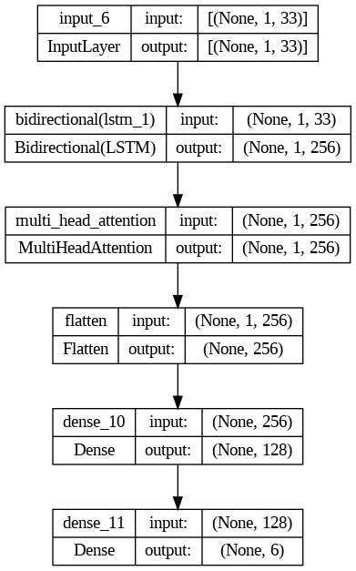
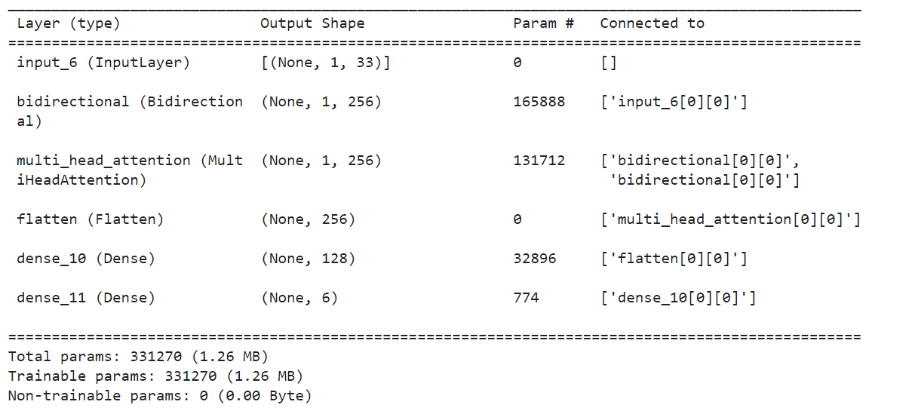
Modules Description and Implementation

Slide 19
Results & Discussions
The dataset has been trained using the four deep learning models(RNN,GRU,LSTM,BiLSTM).
RMSE,MAE and R2 are the matrices used to asses the performance of model.
Appropriate Visualizations for Training and Validation Loss graphs and Training and Accuracy Graphs.
Graphs for the Predicted Time Series of the six pollutants.
Comparison of the models prediction.
Overall work has passed quality tests and is safe for deployment.

Slide 20
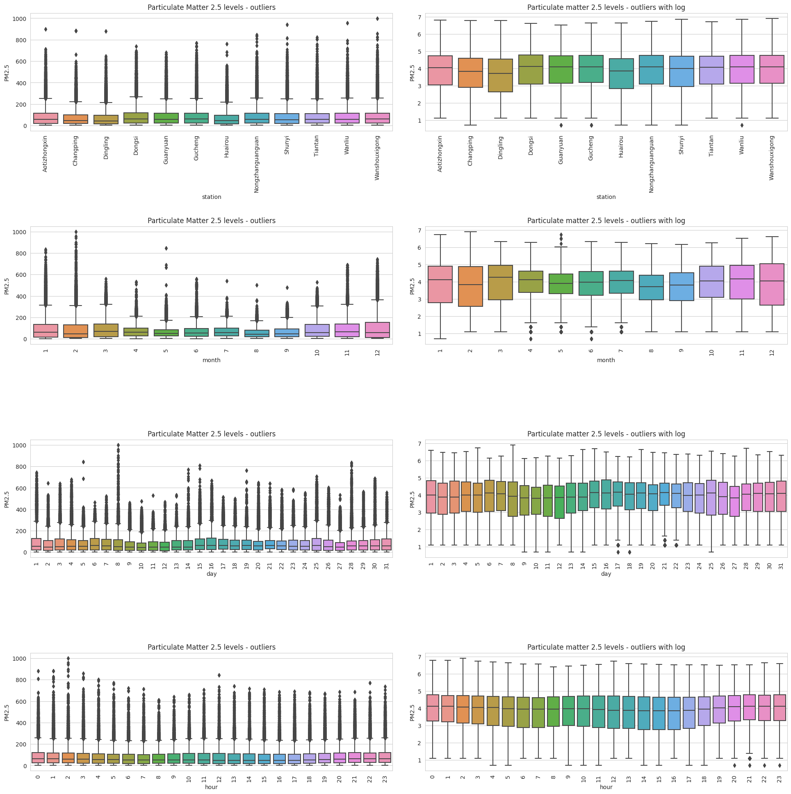
Outliers (PM2.5)

Slide 21
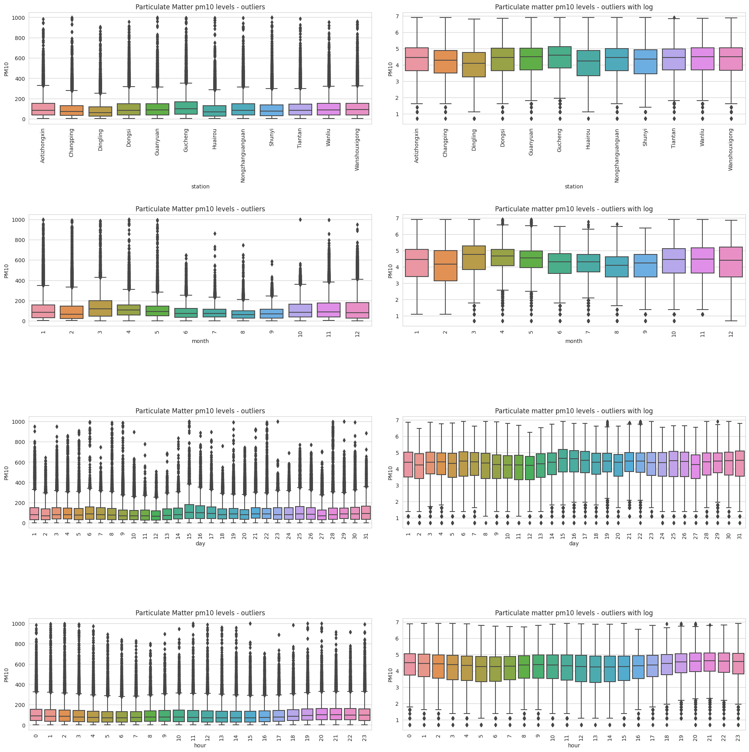
Outliers (PM10)

Slide 22
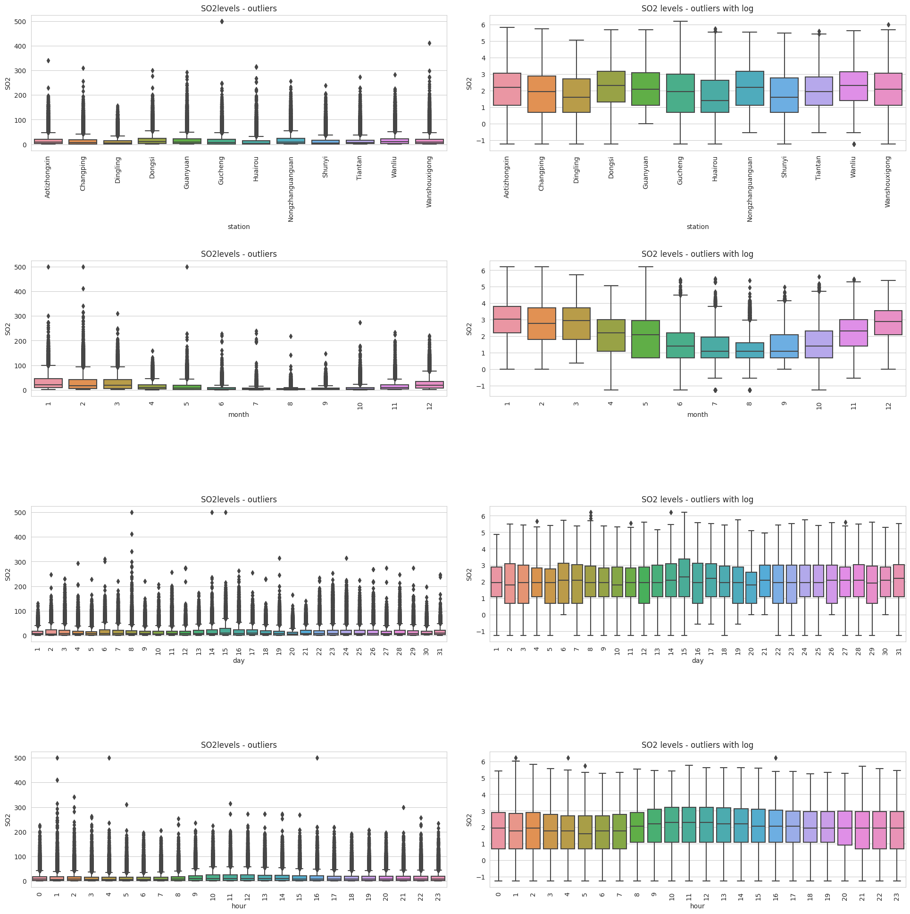
Outliers (SO2)

Slide 23
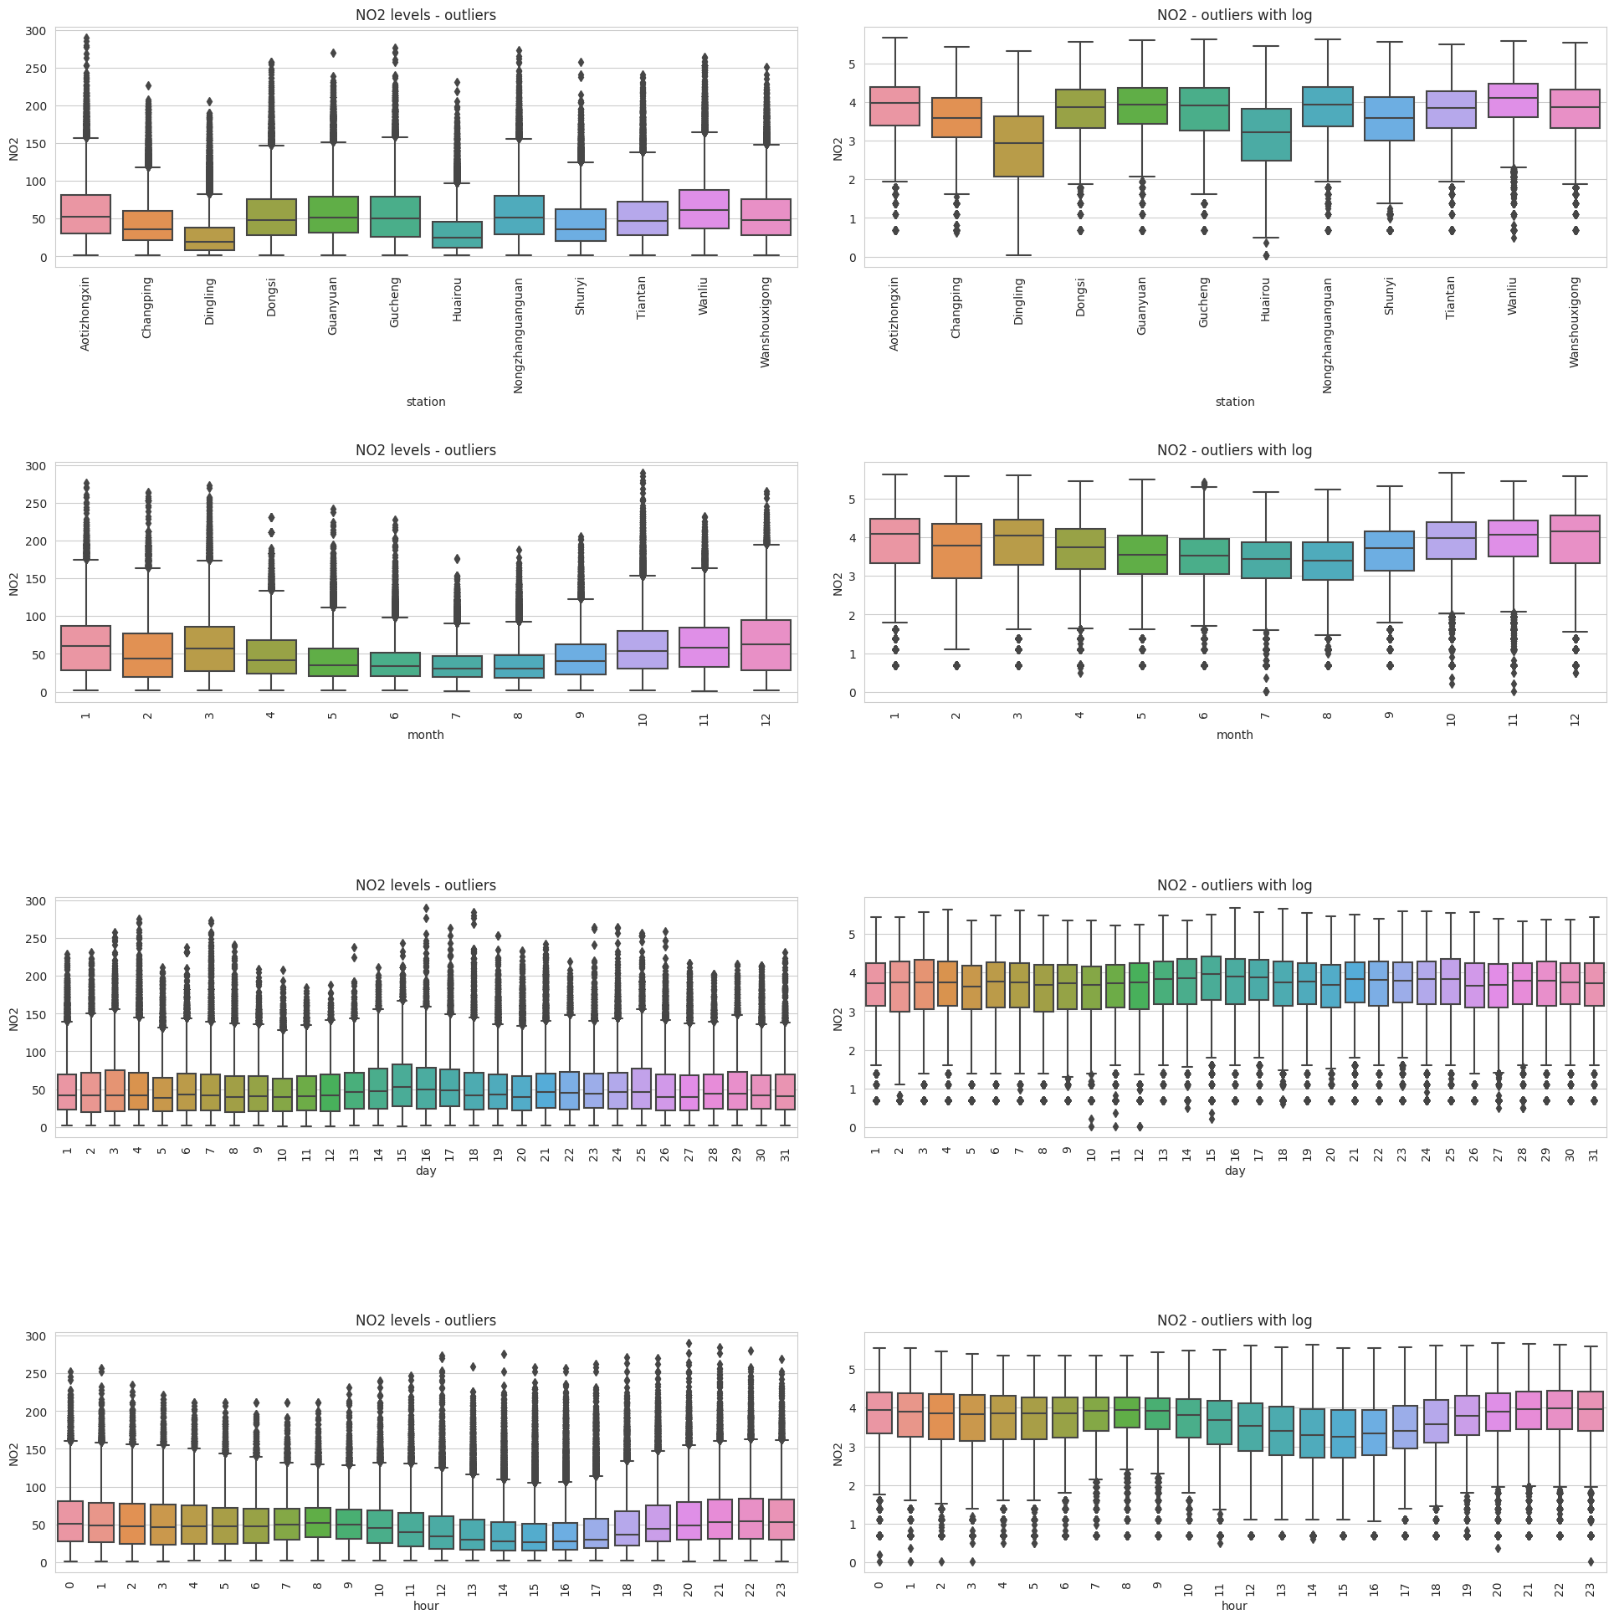
Outliers (NO2)

Slide 24
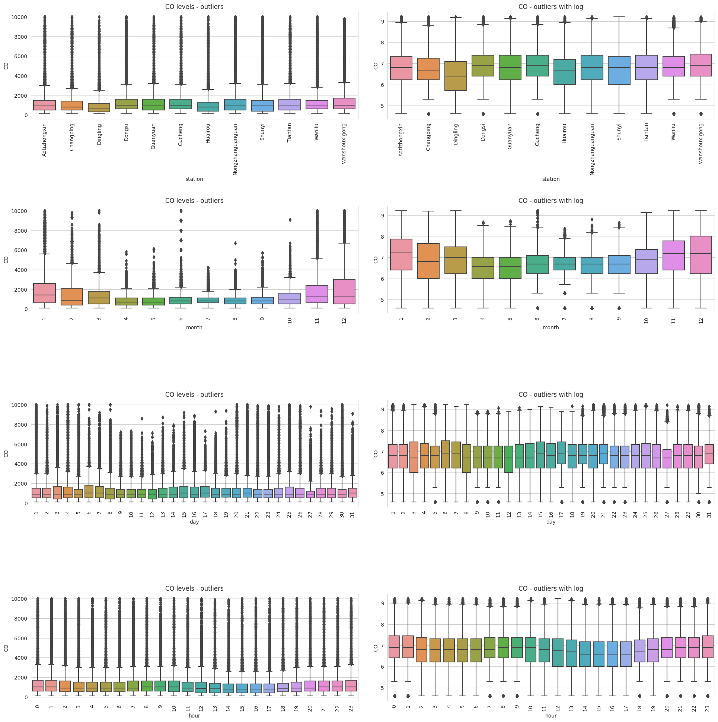
Outliers (CO)

Slide 25
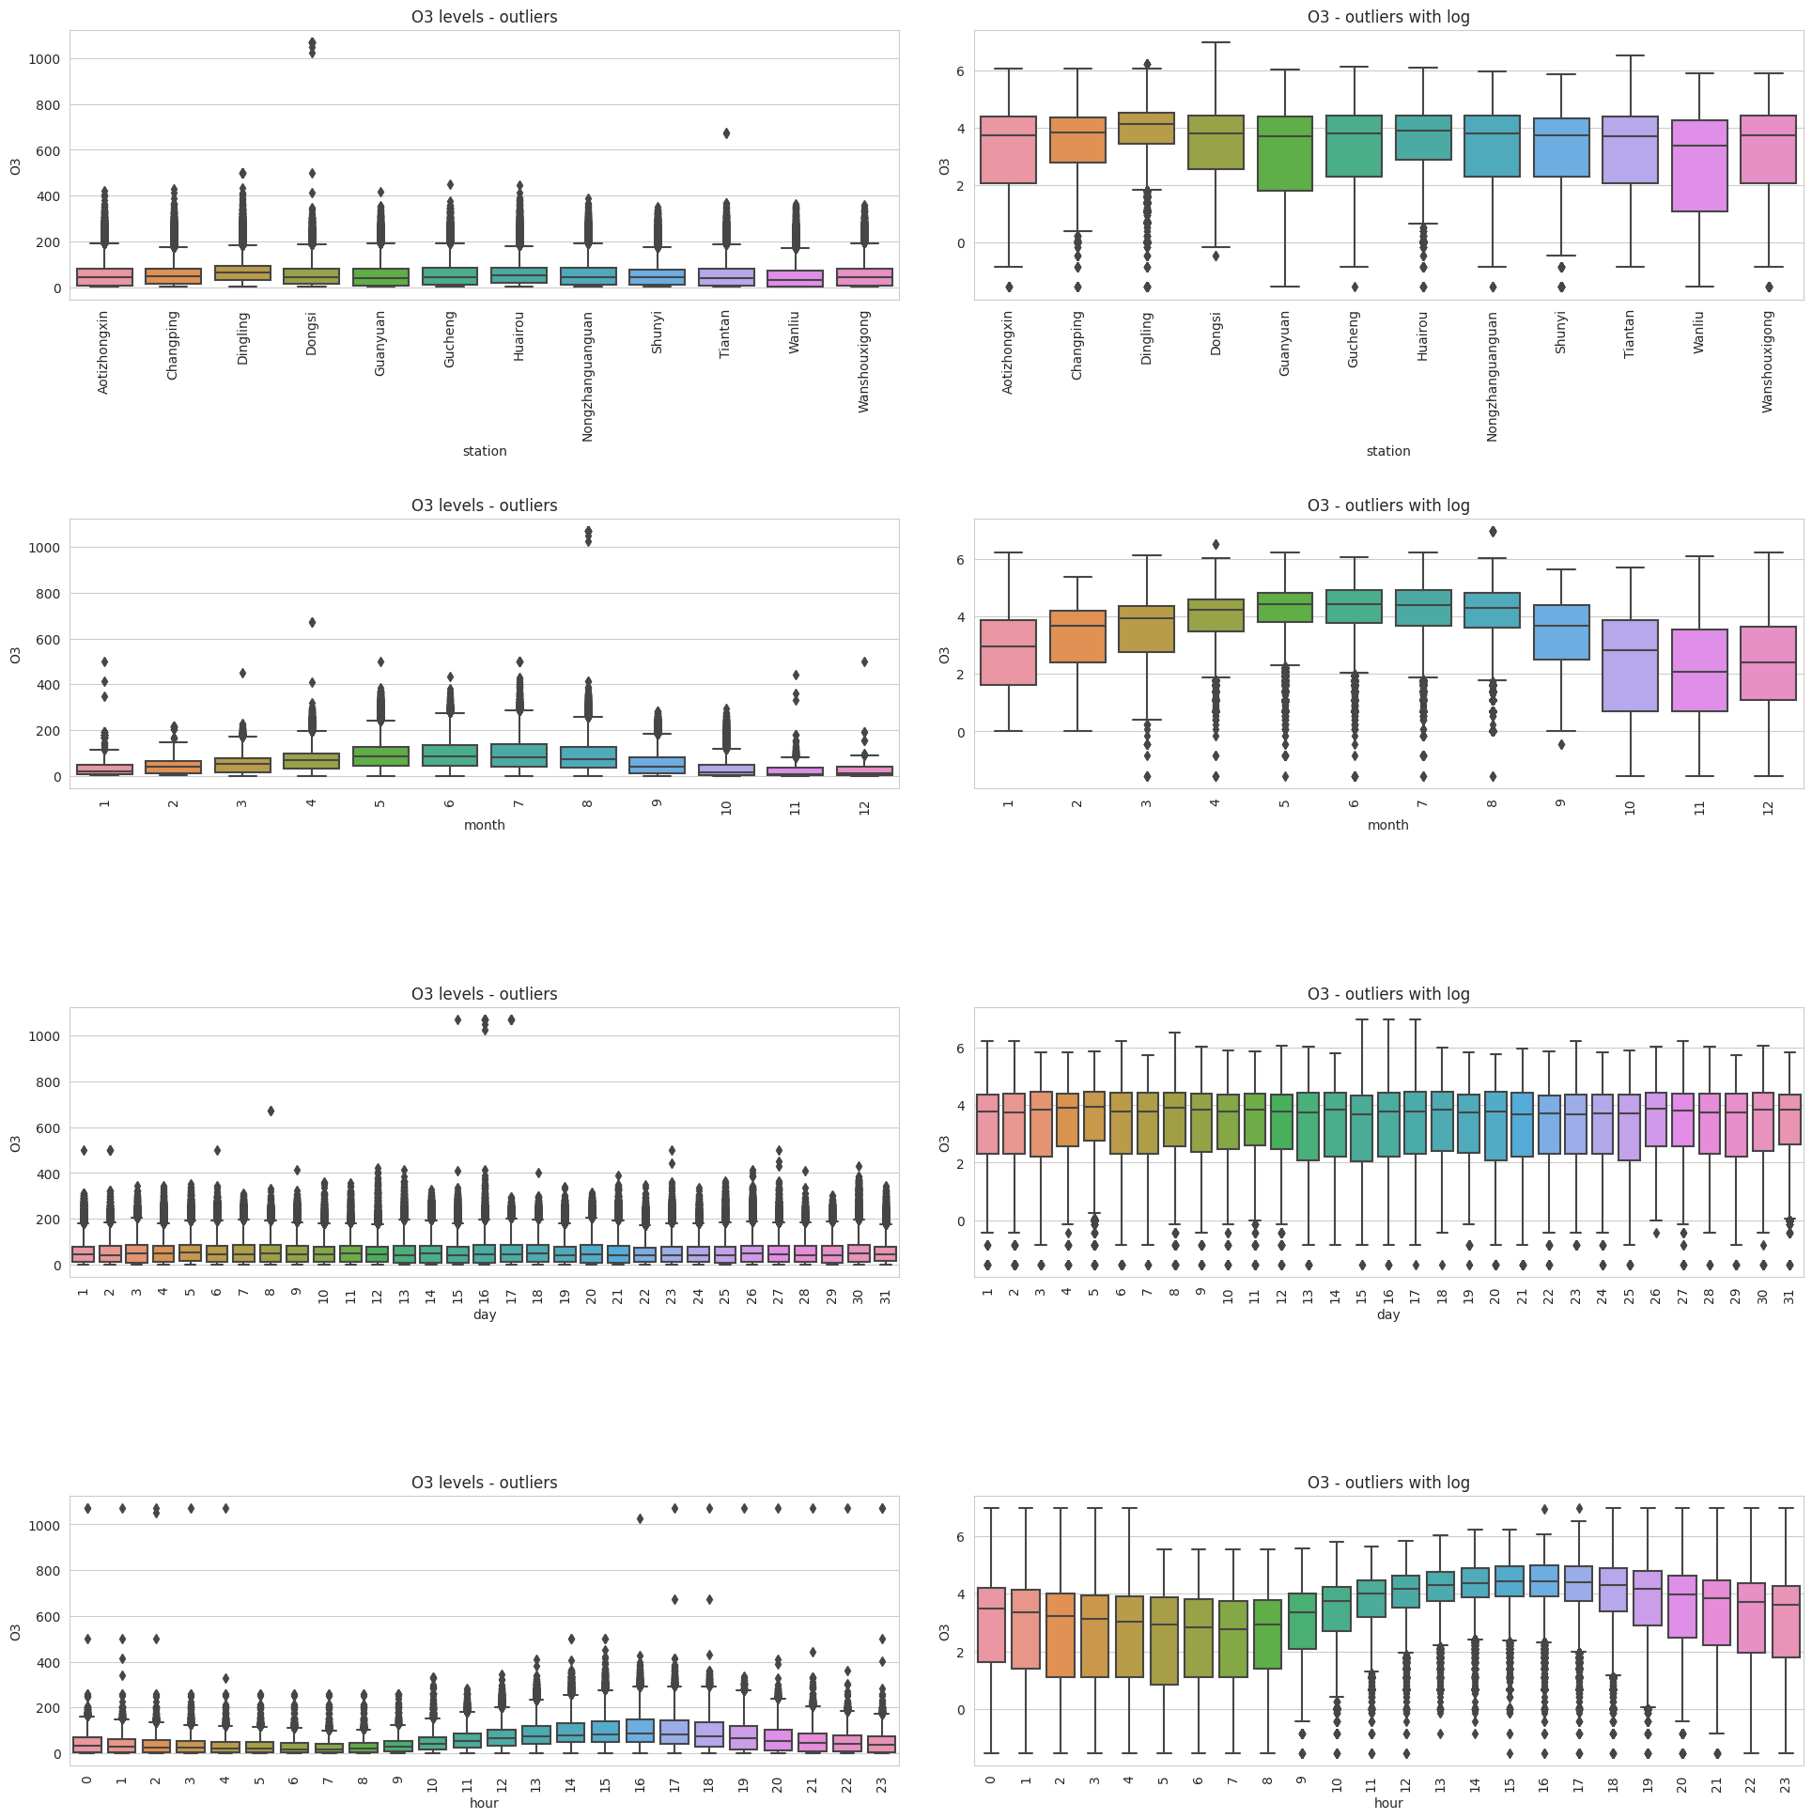
Outliers (O3)

Slide 26
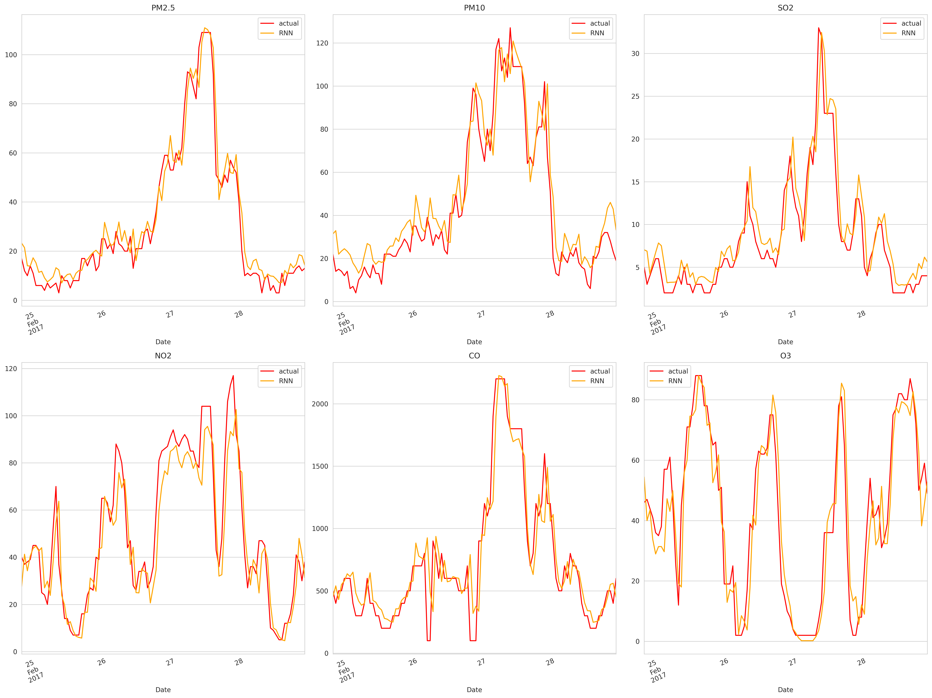
RNN Model prediction

Slide 27
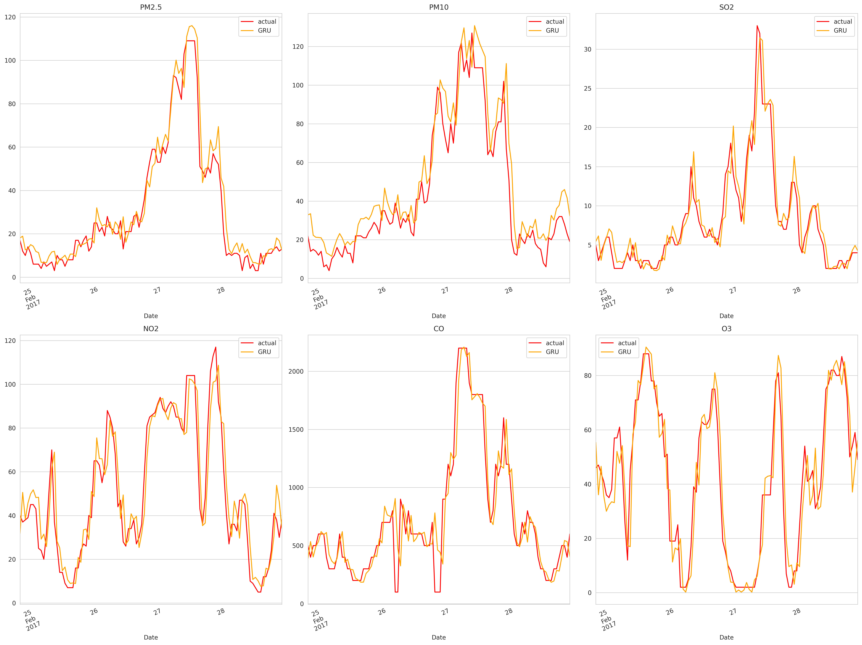
GRU Model Prediction

Slide 28
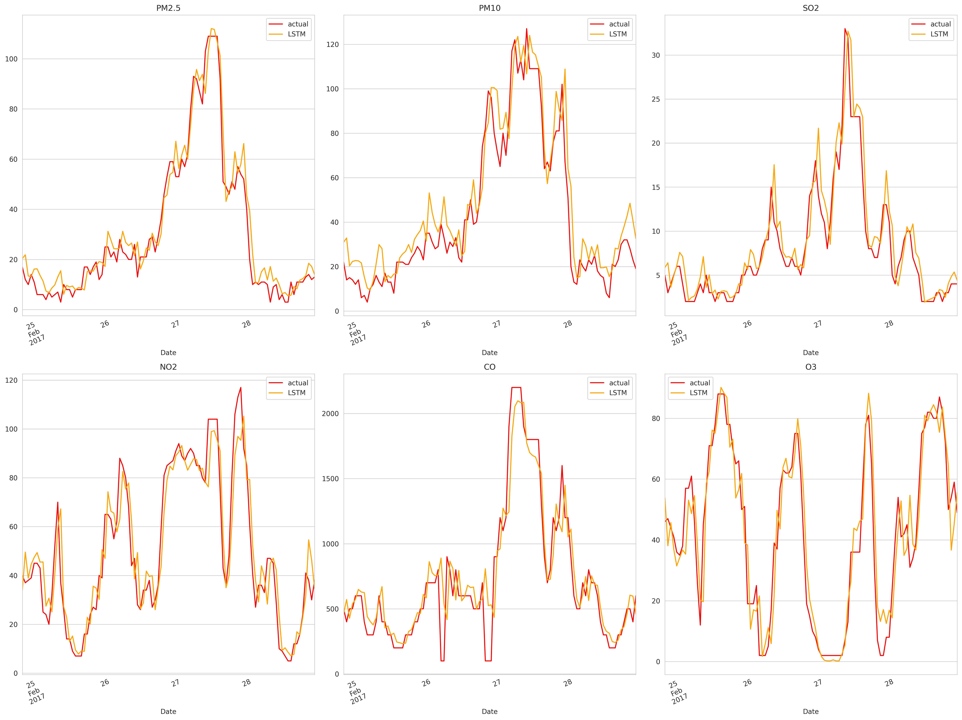
LSTM Model Prediction

Slide 29

BiLSTM Model Prediction

Slide 30
References
[1]Ma, M., & Mao, Z. (2020). Deep Convolution-based LSTM Network for Remaining Useful Life Prediction. IEEE Transactions on Industrial Informatics.
[2]Wan, L., Sun, Y., Lee, I., Zhao, W., & Xia, F. (2020). Industrial Pollution Areas Detection and Location via Satellite-Based IIOT. IEEE Transactions on Industrial Informatics.
[3]Ren, L., Meng, Z., Wang, X., Zhang, L., & Yang, L. T. (2020). A Data-driven Approach of Product Quality Prediction for Complex Production Systems. IEEE Transactions on Industrial Informatics.
[4]V. Chaudhary, A. Deshbhratar, V. Kumar and D. Paul, Time Series Based LSTM Model to Predict Air Pollutant's Concentration for Prominent Cities in India,2021.
[5]R. Janarthanan, P. Partheeban, K. Somasundaram and P. N. Elamparithi, "A deep learning approach for prediction of air quality index in a metropolitan city", Sustain. Cities Soc., vol. 67, pp. 102720, September 2020.

Slide 31
References
[6]V. Chaudhary, A. Deshbhratar, V. Kumar and D. Paul, Time Series Based LSTM Model to Predict Air Pollutant's Concentration for Prominent Cities in India.
[7]A. U. Muhammad, A. S. Yahaya, S. M. Kamal, J. M. Adam, W. I. Muhammad and A. Elsafi, "A hybrid deep stacked LSTM and GRU for water price prediction", Proc. 2nd Int. Conf. Comput. Inf. Sci. (ICCIS), pp. 1-6, Oct. 2020.
[8]K. Ohno and A. Kumagai, "Recurrent neural networks for learning long-term temporal dependencies with reanalysis of time scale representation", Proc. IEEE Int. Conf. Big Knowl. (ICBK), pp. 182-189, Dec. 2021.
[9]Saba Ameer, Munam Ali Shah, Abid Khan, Houbing Song, Carsten Maple, Saif ul Islam, et al., "Comparative Analysis of Machine Learning Techniques for Predicting Air Quality in Smart Cities", IEEE Access, vol. 7, pp. 128325-128338, June 2019.
[10]W. Huang, T. Li, J. Liu, P. Xie, S. Du and F. Teng, "An overview of air quality analysis by big data techniques: Monitoring forecasting and traceability", Inf. Fusion, vol. 75, pp. 28-40, 2021.

Slide 32
Thank You

